Slide 1

Fast Fourier Transform in FPGA
OELP: 1D2802
Mentor: Dr. Subrahmanyam Mula

Slide 2
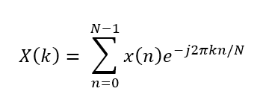
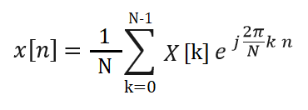
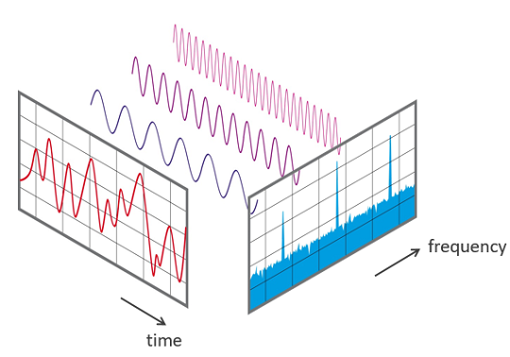
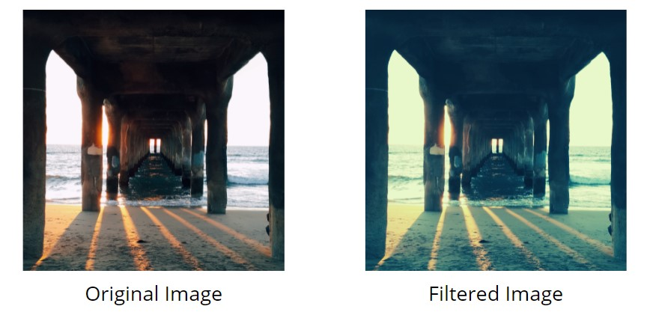
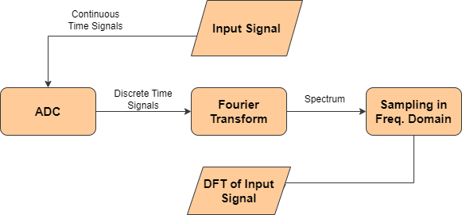
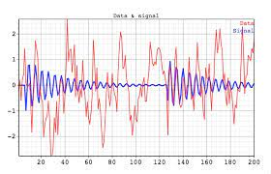

Discrete Fourier Transform
DFT Analysis Equation
DFT Synthesis Equation
DFT Computation

Slide 3
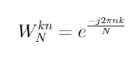
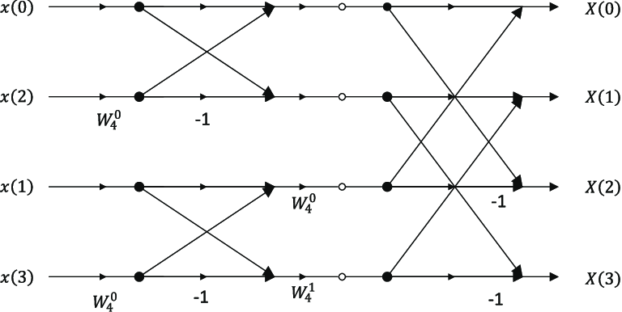
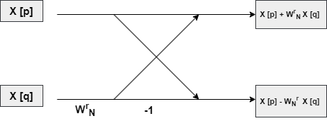
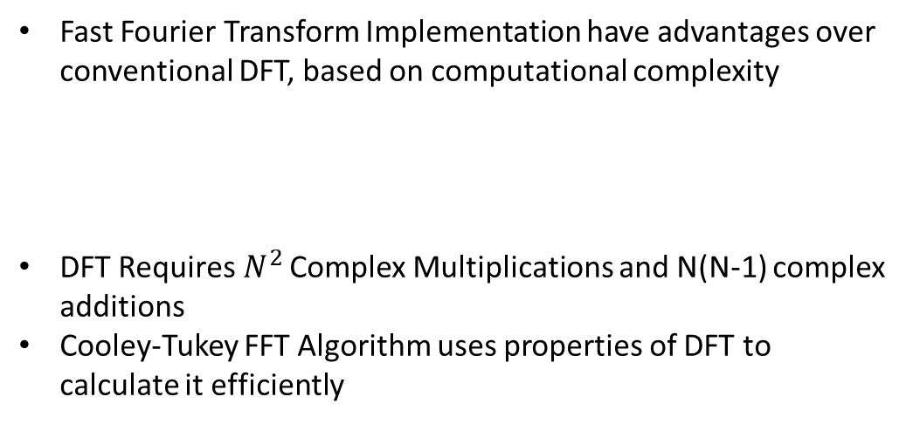
Fast Fourier Transform
Fast Fourier Transform Implementation have advantages over conventional DFT, based on computational complexity
DFT Requires${ N}^{2}$ Complex Multiplications and N(N-1) complex additions
Cooley-Tukey FFT Algorithm uses properties of DFT to calculate it efficiently
Twiddle Factor
4 Point Radix-2 DIT FFT
Butterfly Model for DIT FFT

Slide 4
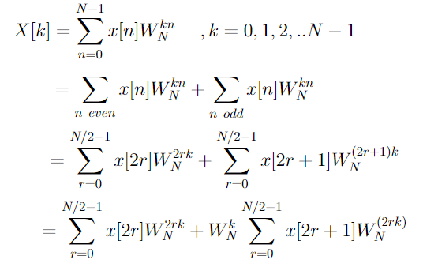
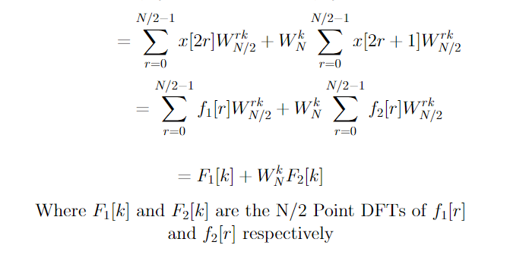
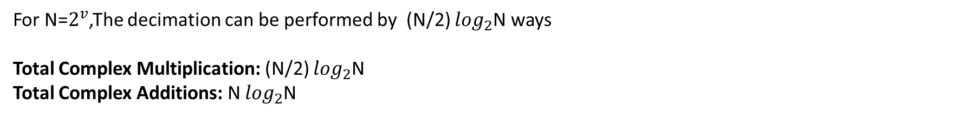
Decimation in Time DFT
Decimation can be continued until it reduces to one-point sequences.
For N=$2^{v}$,The decimation can be performed by (N/2) $\log_{2}$N ways
Total Complex Multiplication: (N/2) $\log_{2}$N
Total Complex Additions: N $\log_{2}$N
Twiddle Factor

Slide 5
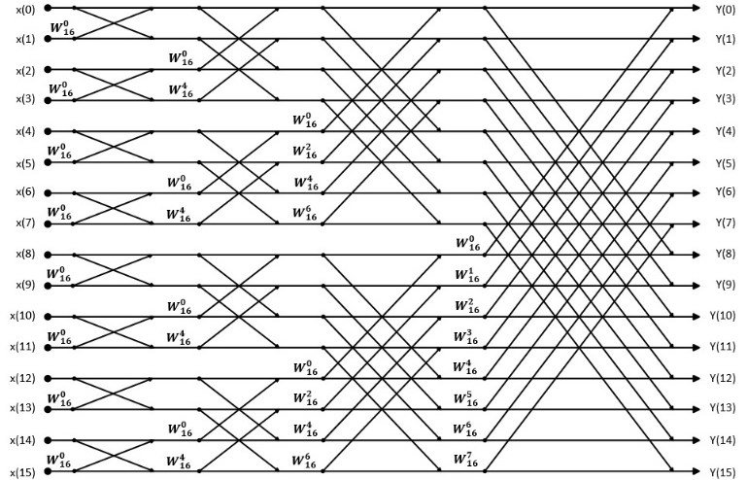
16-Point Decimation in Time FFT

Slide 6
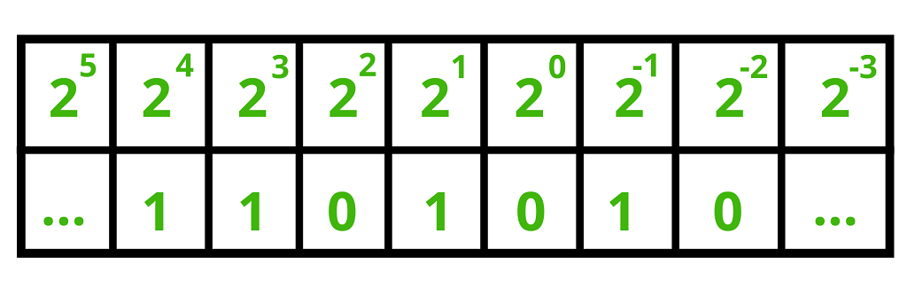
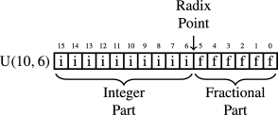
Fixed Point Representation
Fixed point representations are efficient in terms of hardware resources, energy consumption and processing speed compared to floating point.
It is used extensively in Digital Signal Processing and Embedded Systems
Radix Point

Slide 7
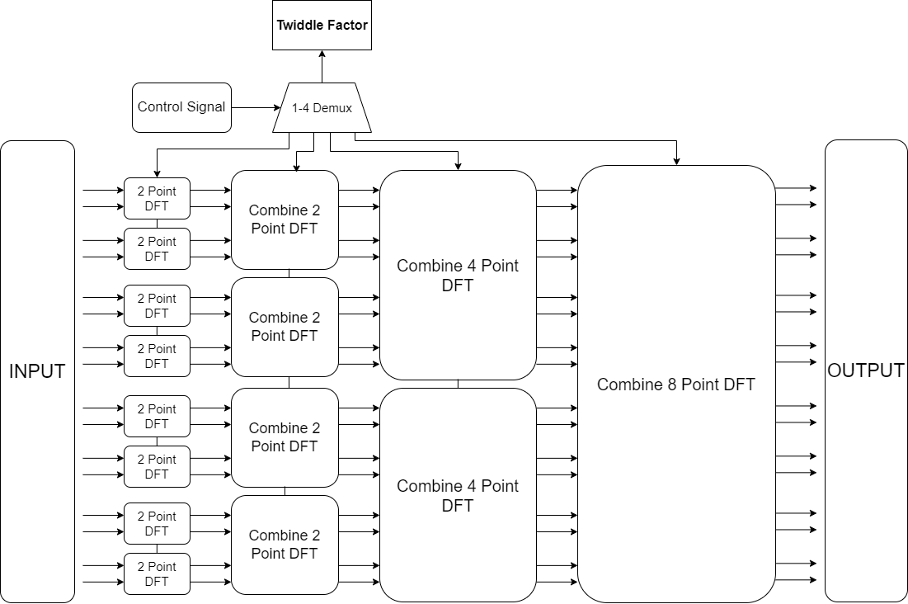
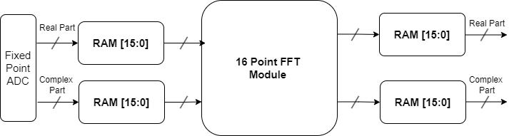
Design Diagram
16 Point FFT Module
Design for 16 Point DIT FFT

Slide 8
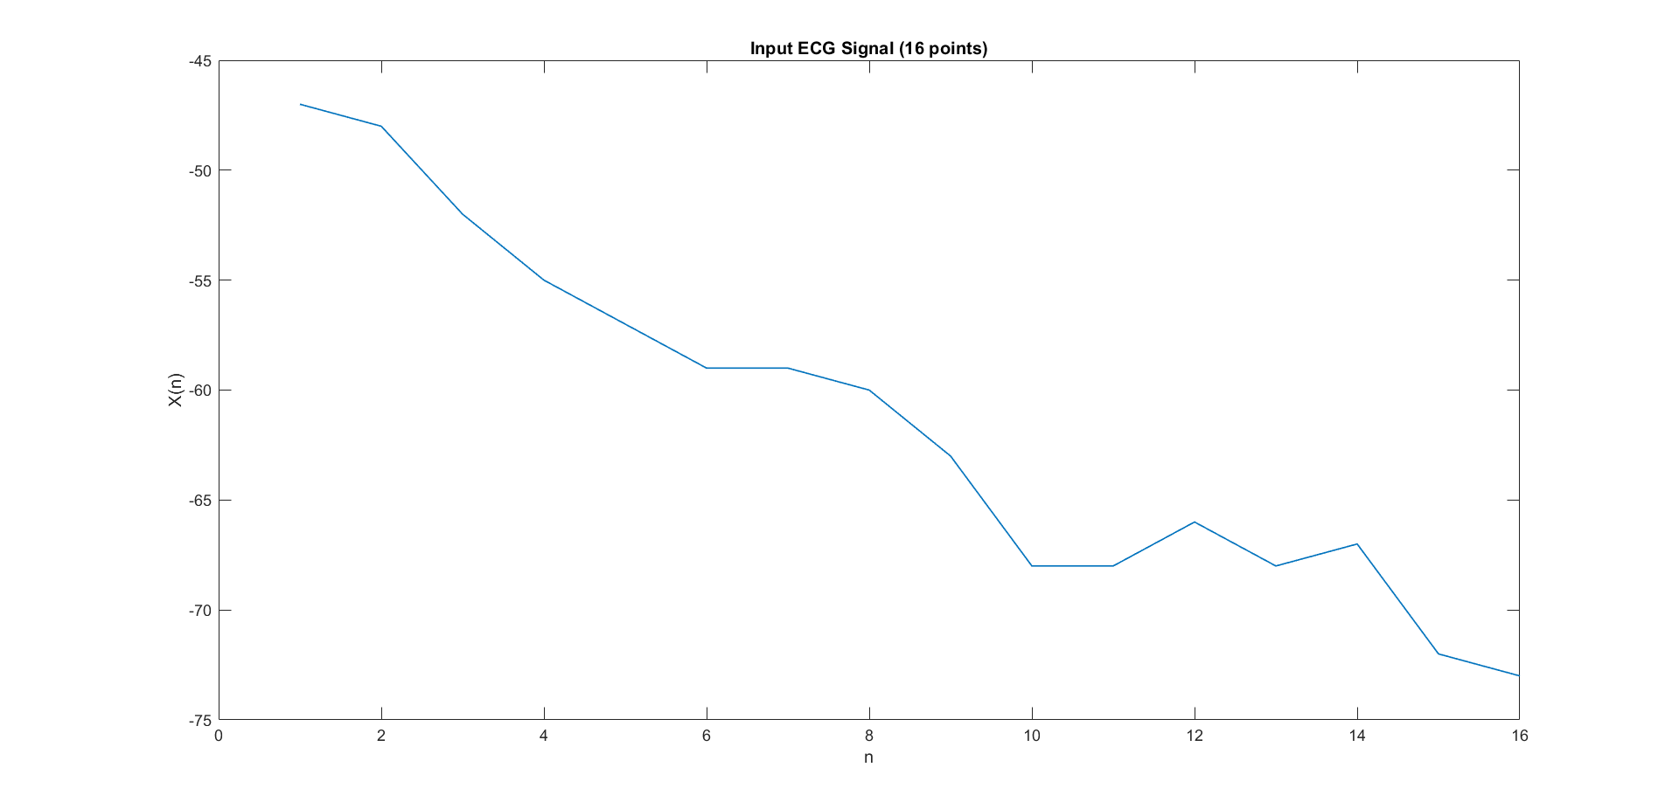
MATLAB Simulation

Slide 9
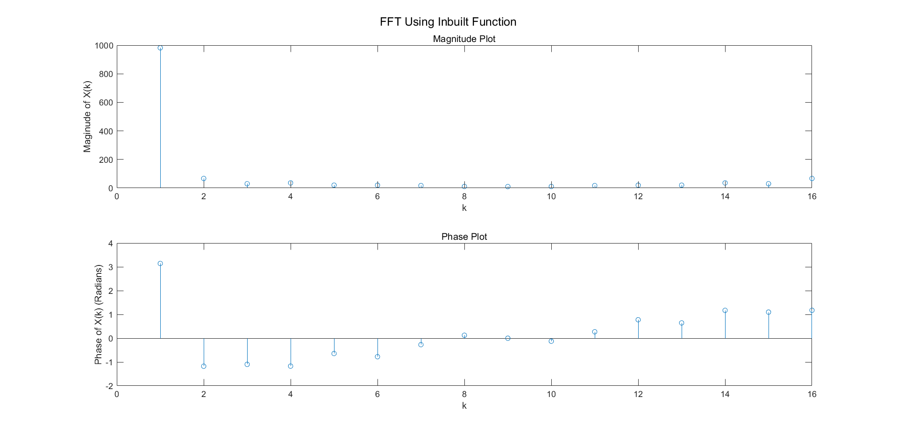

Slide 10


Slide 11
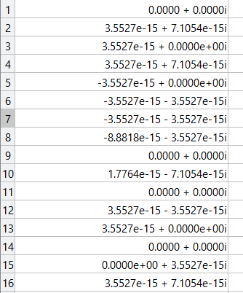
Error Between User Defined and MATLAB Inbuilt FFTs
Error (Due to optimization in Inbuild Functions in MATLAB)

Slide 12
Verilog Implementation Diagram

Slide 13
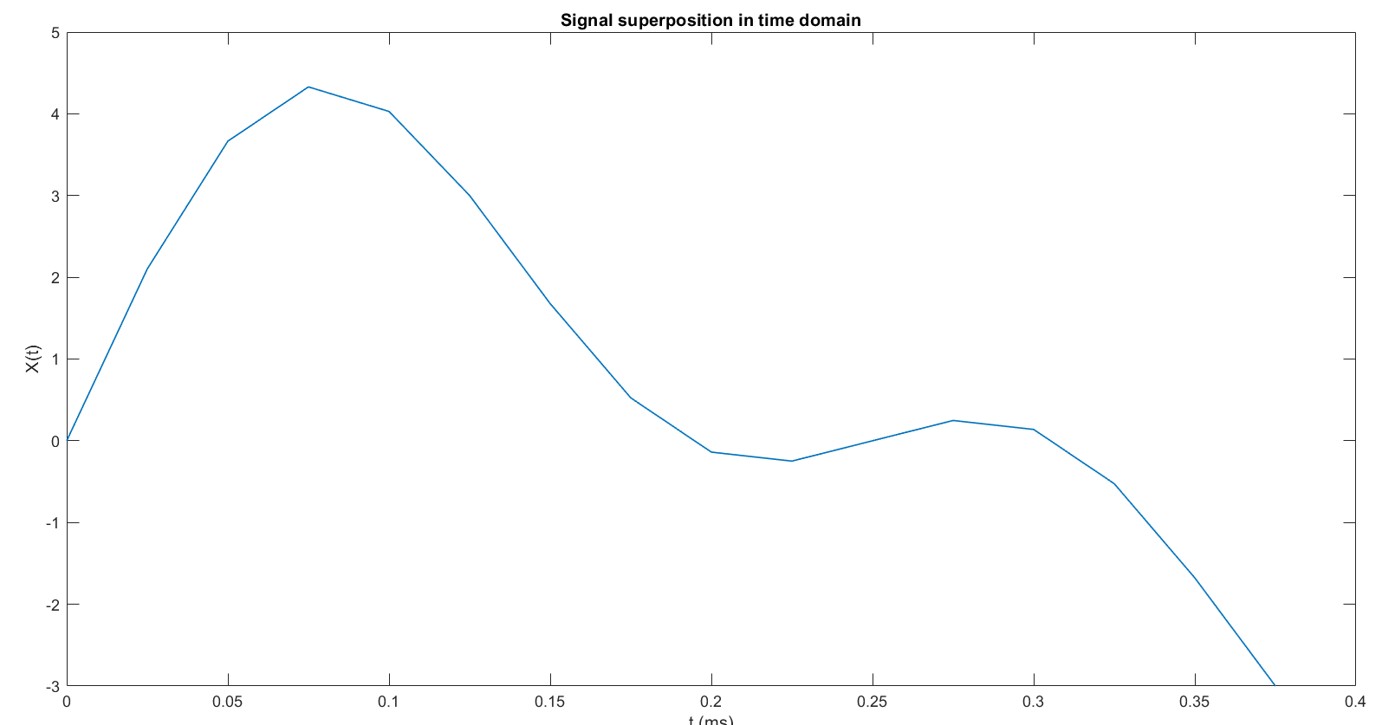
Testing
Test Signal: 3*sin(2*pi*2*t) + 2*sin(2*pi*4*t);
Nyquist Sampling Rate: 2 x 4 = 8, We select 40 Hz (For Increasing Frequency Resolution)
Original Signal’s frequencies are 2Hz and 4Hz.
This will be extracted using FFT Module

Slide 14
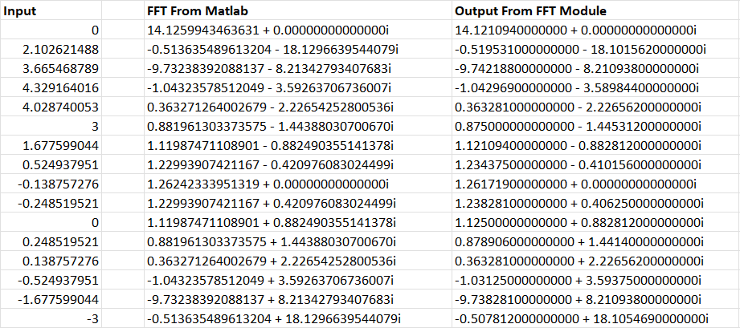
FFT Calculated

Slide 15
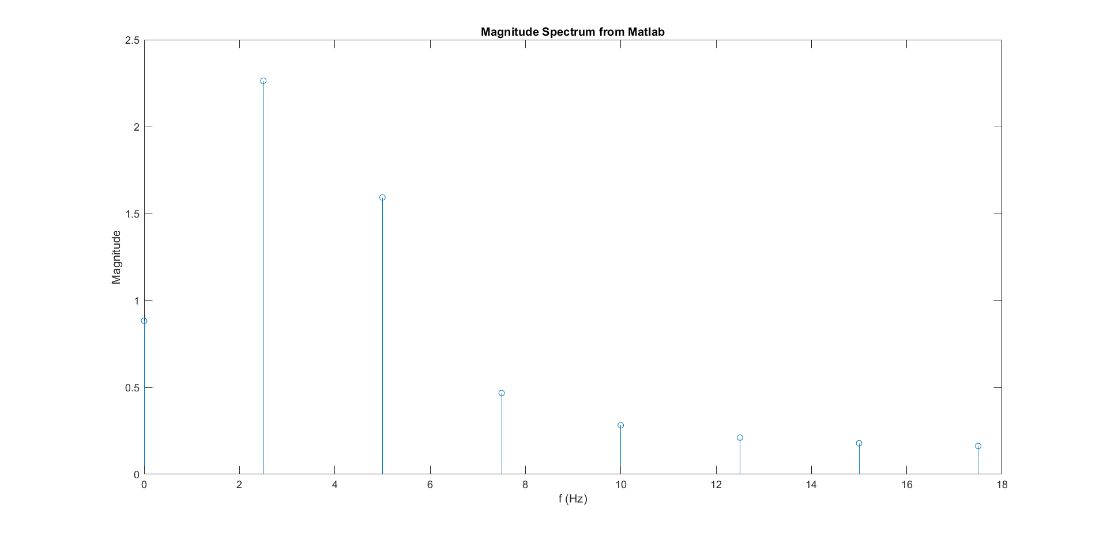

FFT Calculated in MATLAB and Verilog

Slide 16
Conclusion
Implementation of Fast Fourier Transform algorithm was done using MATLAB and in Verilog
The spectrum obtained from Verilog was comparable with software generated Magnitude spectrum
The software implementation of FFT is constrained to execute instructions serially at a time, which is severely dependent on processor performance and it’s instruction throughput.
In real-time processing and Embedded applications, hardware implementation of FFT is essential as it can provides significantly lower latency, by using parallel processing.

Slide 17
Future Work
Extending 16-point FFT to 128 point FFT
Synthesis of the design
Realization of design using FPGA
Real Time Testing with signals from sensors
Using the FFT module for Biomedical signal processing

Slide 18
References
D. Zhang, L. Chen and Y. Wu, "Research on High Precision FFT Algorithm Based on FPGA," 2020 5th International Conference on Intelligent Informatics and Biomedical Sciences (ICIIBMS), Okinawa, Japan, 2020, pp. 42-46, doi: 10.1109/ICIIBMS50712.2020.9336417.
T. Belabed, S. Jemmali and C. Souani, "FFT implementation and optimization on FPGA," 2018 4th International Conference on Advanced Technologies for Signal and Image Processing (ATSIP), Sousse, Tunisia, 2018, pp. 1-6, doi: 10.1109/ATSIP.2018.8364454.
Slade, George. (2013). The Fast Fourier Transform in Hardware: A Tutorial Based on an FPGA Implementation.

